Slide 1
LINQ

Slide 2
Test your understanding
What is a query?
What query language do you use for RDBMS?
What query language do you use for XML?

Slide 3
What is LINQ
Language-Integrated Query
New from .NET 3.5 and VS 2008
Enables using same query language for disparate data sources- SQL, XML or, web services, .NET objects.
Also enables usage of queries against collections.
Object –oriented query language
VS 2008 offers IntelliSense support.
Namespace System.Linq provides the LINQ support.

Slide 4
General form of the query
Declarative query syntax :
var x= from item in data_source
where condition
select item
The query variable x only stores the query commands
The actual execution happens only when some operation is requested like iteration. This is refereed to as deferred execution.
While the syntax allows usage of “var” keyword, what the query really returns is a IEnumerable object.
Hence foreach can be used with the result of LINQ.
Note that LINQ query is case sensitive.

Slide 5
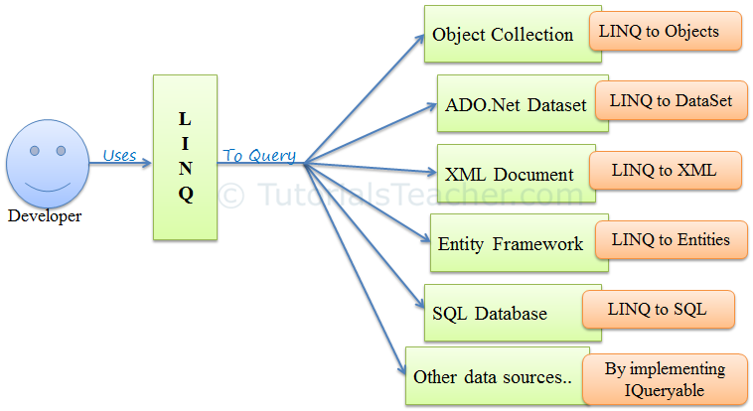
LINQ

Slide 6
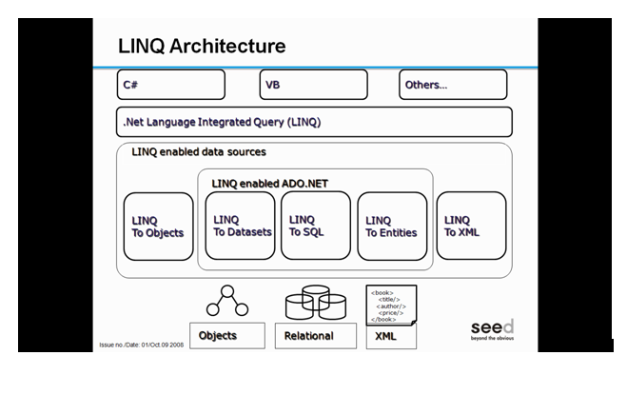

Slide 7
Core Assemblies in LINQ
The core assemblies in LINQ are:
using System.Linq
Provides Classes & Interface to support LINQ Queries
using System.Collections.Generic
Allows the user to create Strongly Typed collections that provide type safety and performance (LINQ to Objects)
using System.Data.Linq
Provides the functionality to access relational databases (LINQ to SQL)
using System.Xml.Linq
Provides the functionality for accessing XML documents using LINQ (LINQ to XML)
using System.Data.Entity
Provides the functionality to access relational databases (Entity Framework)

Slide 8
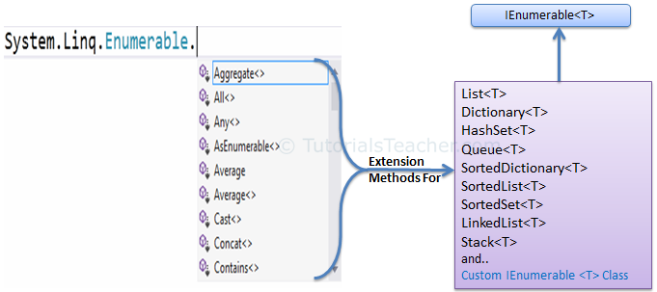
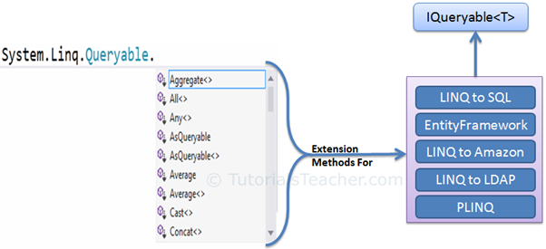
LINQ

Slide 9
LINQ Query Syntax
There are two basic ways to write a LINQ query to IEnumerable collection or IQueryable data sources.
Query Syntax or Query Expression Syntax
Method Syntax or Method extension syntax
Query Syntax:
Query syntax is similar to SQL (Structured Query Language) for the database. It is defined within the C# or VB code.
from <range variable> in <IEnumerable<T> or IQueryable<T> Collection>
<Standard Query Operators>
<select or groupBy operator> <result formation>

Slide 10
LINQ Query Syntax
Declarative query syntax :
var x= from item in data_source
where condition
select item
The query variable x only stores the query commands
The actual execution happens only when some operation is requested like iteration. This is refereed to as deferred execution.
While the syntax allows usage of “var” keyword, what the query really returns is a IEnumerable object.
Hence foreach can be used with the result of LINQ.
Note that LINQ query is case sensitive.

Slide 11
Standard Query Operators
Classification | Standard Query Operators
Filtering | Where, OfType
Sorting | OrderBy, OrderByDescending, ThenBy, ThenByDescending, Reverse
Grouping | GroupBy, ToLookup
Join | GroupJoin, Join
Projection | Select, SelectMany
Aggregation | Aggregate, Average, Count, LongCount, Max, Min, Sum
Quantifiers | All, Any, Contains
Elements | ElementAt, ElementAtOrDefault, First, FirstOrDefault, Last, LastOrDefault, Single, SingleOrDefault
Set | Distinct, Except, Intersect, Union
Partitioning | Skip, SkipWhile, Take, TakeWhile
Concatenation | Concat
Equality | SequenceEqual
Generation | DefaultEmpty, Empty, Range, Repeat
Conversion | AsEnumerable, AsQueryable, Cast, ToArray, ToDictionary, ToList

Slide 12
LINQ with Objects
The term "LINQ to Objects" refers to the use of LINQ queries Objects that implement IEnumerable , meaning all collection classes like List, Dictionary as well as arrays and string can use LINQ.
The collection name become the data source.
var x= from item in data_source
where condition
select item
The from clause similar to the for-each statement.
An identifier is used to refer to individual item in the collection. The where clause uses this identifier name to filter the collection.
The query returns IEnumerable object.
The assembly System.Linq needs to be included to work with LINQ.

Slide 13
Example : LINQ with array
using System;
using System.Linq;
class Program{
static void Main(string[] args) {
string[] flowers = { "dahlia", "rose", "lotus", "lily", "hibiscus", "daffodil" };
var fQuery =
from flower in flowers
where (flower.StartsWith("d"))
select flower;
foreach (string f in fQuery) {
Console.WriteLine(f);
} }}
The same query can be run multiple times since query itself does not produce any results.
Or IEnumerable<string>
Execution happens here
On execution :
dahlia
daffodil

Slide 14
Example : LINQ with string
String is nothing but an array of characters.
Therefore LINQ query can be used with the string to search based on characters.
class Program{
static void Main(string[] args) {
string poem = @"What is this life if, full of care,
We have no time to stand and stare.
No time to stand beneath the boughs
And stare as long as sheep or cows.
No time to see, when woods we pass,
Where squirrels hide their nuts in grass.
No time to see, in broad daylight,
Streams full of stars, like skies at night.
No time to turn at Beauty's glance,
And watch her feet, how they can dance.
No time to wait till her mouth can
Enrich that smile her eyes began.
A poor life this if, full of care,
We have no time to stand and stare";

Slide 15
var matchQuery = from c in poem
where c == ','
select c;
int i = 0;
foreach (char c in matchQuery)
{
i++;
}
Console.WriteLine(i);
}
On execution : 11

Slide 16
More on select and from clause
Select can be used to return a computed value as well.
var fQuery =
from flower in flowers
where (flower.StartsWith("d"))
select flower.ToUpper();
For the collection that implements IEnumerable<T> it is not compulsory to specify the type in the from clause. But for the collection that implements IEnumerable, the type has to be specified in from clause
select flower;
var fQuery =
from string flower in flowers
where (flower.StartsWith("d"))
select flower;

Slide 17
Exercise
Given an array of numbers. Find the cube of the numbers that are greater than 100 but less than 1000 using LINQ.
Change some of the array elements and execute the same query again.
Hint : use the logical operators of C# to combine the conditions
(15 mins)
Notes:
&&, ||

Slide 18
Multiple where clause and let
Query can have any number of where clause to filter that data.
var fQuery =from flower in flowers
where flower.StartsWith("d")
where flower.Length>7
select flower;
This is same as
var fQuery = from flower in flowers
where flower.StartsWith("d") || flower.Length>7
select flower;
The keyword let can be used retain temporary value.
var lquery = from flower in flowers
let len = flower.Length
where len > 5 && len <7
select flower;

Slide 19
Compound from clauses
Data from multiple data sources can be obtained using multiple from clause. The example listed results in producing Cartesian product between the two data sources.
using System;
using System.Linq;
using System.Collections.Generic;
struct Flowerfruit{
public string flower;
public string fruit;
public Flowerfruit(string fl, string fr) {
flower=fl;
fruit = fr;
}
}

Slide 20
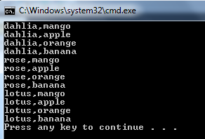
class Program{
static void Main(string[] args) {
string[] flowers = { "dahlia", "rose", "lotus" };
string[] fruits = { "mango", "apple", "orange", "banana" };
var fQuery =
from flower in flowers
from fruit in fruits
select new Flowerfruit(flower, fruit);
foreach (Flowerfruit f in fQuery)
{
Console.WriteLine(f.flower+"," +f.fruit);
}
}
}

Slide 21
Exercise
Given a list of participants for a tennis match. Split the list into 2 equal halves and display all the possible combination of matches possible between the participants in the two lists. A condition is that no player should have an opponent who is from his own his own country.
(45 mins)

Slide 22
Sorting
orderby clause is used to sort on one or more fields.
orderby default arranges the elements in ascending order.
orderby ascending or order by descending can also be used to arranges the elements in ascending order or descending order.
using System;
using System.Linq;
using System.Collections.Generic;
class Flower{
public Flower(string n, int p) {
Name = n;
Petals = p; }
public string Name { get; set; }
public int Petals { get; set; }
}

Slide 23
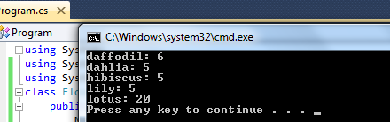
class Program{
static void Main(string[] args) {
List<Flower> FlowerList = new List<Flower>();
FlowerList.Add(new Flower("dahlia", 5));
FlowerList.Add(new Flower("lotus", 20));
FlowerList.Add(new Flower("lily", 5));
FlowerList.Add(new Flower("daffodil", 6));
FlowerList.Add(new Flower("hibiscus", 5));
// Using LINQ with Collections
var lquery = from Flower flower in FlowerList
where flower.Petals > 4
orderby flower.Name , flower.Petals descending
select flower;
foreach (Flower f in lquery)
Console.WriteLine(f.Name + ": " + f.Petals);
}
}
Note that we need to specify the type here
Note how collection has been used in LINQ.

Slide 24
Exercise
Create an Order class that has order id, item name, order date and quantity. Create a collection of Order objects. Display the data day wise from most recently ordered to least recently ordered and by quantity from highest to lowest.
Hint: Use order date type as System.DateTime . Use DateTime(int year, int month, int day) constructor.
(45 mins)

Slide 25
Exercise
Create an Order class that has order id, item name, order date and quantity. Create a collection of Order objects. Display the data day wise from most recently ordered to least recently ordered and by quantity from highest to lowest.
Hint: Use order date type as System.DateTime . Use DateTime(int year, int month, int day) constructor.
(45 mins)

Slide 26
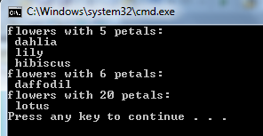
group
A LINQ query starts with from clause and end with either a select clause or group clause.
group clause allows grouping the results with respect to certain criteria.
var lquery = from Flower flower in FlowerList
orderby flower.Petals
group flower by flower.Petals;
foreach (var f in lquery) {
Console.WriteLine("flowers with "+ f.Key+ " petals: ");
foreach (var nm in f)
Console.WriteLine(" "+nm.Name);

Slide 27
Exercise
For the previous exercise, write a LINQ query that displays the details grouped by the month in the descending order of the order date.
(30 mins)

Slide 28
Joining
Joining refers to combining data from two data sources based on some common fields in both the data sources.
Syntax:
from var1 in DataSource1
join var2 in DataSource2
on var1.property equals var2.property

Slide 29
Example
class Student {
public int Id{get; set;}
public string Name { get; set; }
public Student(int id, string name) {
this.Id = id;
this.Name = name;
}
}
class Enroll {
public int Id { get; set; }
public string CourseName{ get; set; }
public Enroll(int id, string name) {
this.Id = id;
this.CourseName = name;
}
}

Slide 30
class StudentEnroll {
public int Id { get; set; }
public string Name { get; set; }
public string CourseName { get; set; }
public StudentEnroll(int id, string name,
string cname) {
this.Id = id;
this.Name = name;
this.CourseName = cname;
}
}
class Program {
static void Main(string[] args) {
Student[] students = { new Student(1, "Hari"), new Student(2, "Ravi"), new Student(3, "Narender"), new Student(4, "Sandeep") };
Enroll[] enrollments = { new Enroll(1, ".NET"), new Enroll(2, "SAP"), new Enroll(3, "SAP"), new Enroll(4, "SAP") };

Slide 31
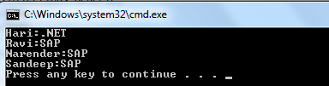
var join = from s in students
join e in enrollments on s.Id equals e.Id
select new StudentEnroll(s.Id, s.Name, e.CourseName);
foreach (var ex in join) {
Console.WriteLine(ex.Name + ":" + ex.CourseName);
}
}
}

Slide 32

Query continuation
The temporary results can be saved and can be used in the subsequent part of the query. This is called query continuation or just continuation.
into clause is used to achieve this.
If we need the result of the previous example grouped by the course name then the query would be:
var join1 = from s in students
join e in enrollments on s.Id equals e.Id
select new StudentEnroll(s.Id, s.Name, e.CourseName) into es
group es by es.CourseName;
foreach (var ex in join1) {
Console.WriteLine(ex.Key);
foreach (var ex1 in ex)
Console.WriteLine(" "+ex1.Id+ " "+ ex1.Name);}

Slide 33
Exercise
You have created Order class in the previous exercise and that has order id , item name, order date and quantity . Create another class called Item that has item name and price. Write a LINQ query such that it returns order id, item name, order date and the total price (price * quantity ) grouped by the month in the descending order of the order date.
(45 mins)

Slide 34
Anonymous types
Instead of creating a class for maintaining relationship, like StudentEnroll class, C# allows creation of anonymous types (class with no name).
This is used with the select clause to return an object in cases where there are no class to represent the object ( as a result of join or if the query has only subset of the fields in a data source).
Syntax: new { field1=value1, field2=value2, …}
Example:
var join = from s in students
join e in enrollments on s.Id equals e.Id
select new { ID = s.Id, Name = s.Name, CName = e.CourseName };
foreach (var ex in join) {
Console.WriteLine(ex.Name + ":" + ex.CName); }
An anonymous class with ID, Name and CName read-only properties are created.

Slide 35
Exercise
Do the previous exercise using anonymous types.
(30 mins)

Slide 36
Query Methods
Query methods provide a short cut way of writing queries.
These methods can be used on any enumerable object.
System.Linq.Enumerable methods have query methods and these extend the functionality of IEnumerable<T>
Methods:
Select
Where
OrderBy, OrderByDescending
Join
GroupBy
Example: var l= FlowerList.Select(e => e.Name);

Slide 37
Lambda expression
The conditional expression that the LINQ uses with the where clause is actually passed as an argument to the Where method: Where(flower.Petals => flower.Petals == 5).
The above expression is called Lambda expression.
A lambda expression is an anonymous function that can be used to create delegates or expression tree types.
=> is the lambda operator, which is read as "goes to".
While many LINQ can be written without the knowledge of Lambda expression, some queries can only be expressed in method syntax and require us to use lambda expressions.
It is very easy to use aggregate functions with lambda expression.

Slide 38
Lambda expression example
using System;
class X
{
delegate int cube(int i);
static void Main(string[] args)
{
cube myDelegate = x => x*x*x;
int j = myDelegate(5);
Console.Write(j);
}
}
//Prints 125

Slide 39
Using Lambda expression in LINQ
This example converts the first example that we created using lambda expression.
string[] flowers = { "dahlia", "rose", "lotus", "lily", "hibiscus", "daffodil" };
IEnumerable<string>f = flowers.Where(flower=>flower.StartsWith("d"));
foreach (string g in f) {
Console.WriteLine(g);
}

Slide 40
Examples using query methods
For the students and enrollments collection
var q= students.Where(s => s.Id == 4).Select(st => st);
var q= students.OrderBy(s=>s.Name).Select(st => st);
var q= enrollments.GroupBy(e=> e.CourseName);
var q = students.Join(enrollments, s => s.Id, e => e.Id, (s, e) => new { s.Name, e.CourseName });
var q = (students.Join(enrollments, s => s.Id, e => e.Id, (s, e) => new { s.Name, e.CourseName })).GroupBy(k => k.CourseName);
The last one is the same query as the example for Query continuation

Slide 41
Other LINQ Methods
All()
Any()
Contains()
Uses the Equals() method of the class to determine if the element specified is in the collection.
First()
Last()
Console.WriteLine(students.Any(x => x.Id > 5)); // False

Slide 42
Exercise
Check if all the quantities in the Order collection is >0.
Get the name of the item that was ordered in largest quantity in a single order. (Hint: use LINQ methods to sort)
Find if there are any orders placed before Jan of this year.
(30 mins)

Slide 43
Aggregate methods
Count()
Sum()
Min()
Max()
Average()
These LINQ methods produce single (non-sequential) result. So in such cases, immediate execution takes place.
Console.WriteLine(flowers.Count(x =>x.StartsWith("d")));
Notes:
LINQ we encountered so far produced sequential result (one or more row of data) and so their execution was deferred.
With query that produces single result, query execution happens immediately even though the foreach has not be called.

Slide 44
Example: Count
string poem = @"What is this life if, full of care,
We have no time to stand and stare.
No time to stand beneath the boughs
And stare as long as sheep or cows.
No time to see, when woods we pass,
Where squirrels hide their nuts in grass.
No time to see, in broad daylight,
Streams full of stars, like skies at night.
No time to turn at Beauty's glance,
And watch her feet, how they can dance.
No time to wait till her mouth can
Enrich that smile her eyes began.
A poor life this if, full of care,
We have no time to stand and stare";
int i = (from c in poem where c == ','select c).Count();
Console.WriteLine(i);
}
Prints: 11
Notes:
The example that we used to count the number of characters in a string, becomes very simple when we use Count aggregate.
Same thing can be written achieved by statement
Console.WriteLine(poem.Where(e=>e==',').Count());

Slide 45

Query count with continuation
The temporary results can be saved and can be used in the subsequent part of the query.
This is called query continuation or just continuation.
into clause is used to achieve this.
var lquery = from Enroll s in enrollments
group s by s.CourseName into fs
where fs.Count() > 1
select fs;
foreach (var f in lquery) {
Console.WriteLine(f.Key );
foreach (var nm in f)
Console.WriteLine(" " + nm.Id);
}

Slide 46
Activity
Rewrite the last two example of that used Count using LINQ query methods entirely.
(15 minutes)
Notes:
int i = poem.Select(c => c == ',').Count();
Console.WriteLine(i);
int evenNumbers = numbers.Count(n => n % 2 == 0);

Slide 47
Exercise
Given the array of numbers. Count and display even numbers.
(15 minutes)
Write LINQ to get the sum of quantities for each item and also find out and display the item that has overall maximum orders.
(45 mins)

Slide 48
Distinct
Distinct()returns result set without the duplicate values.
int[] nums = { 1, 1, 2, 3, 5, 7, 5 };
var results = nums.Select(e=>e).Distinct();
foreach (var n in results){ Console.WriteLine(n); }

Slide 49
LINQ with XML
.NET provides a set of new class are provided to work with LINQ.
XDocument , XElement, XAttribute represent an xml document, element and attribute.

Slide 50
XElement members
Name, Value, FirstNode, LastNode, FirstAttribute, LastAttribute, HasAttribute, NextNode, PrevNode, Document, Document, NodeType
void Add(Object), void AddFirst(Object),
XmlReader CreateReader() , XmlWriter CreateWriter()
void Load(String), void Load(Stream), void Load(XmlWriter), void Load(TextReader)
void Remove(), void RemoveAll()
void Save(String), void Save(Stream), void Save( (XmlWriter), void Save(TextReader)
XDocument also more or less has same members.

Slide 51
Example: filtering xml document
This example returns only those customers who live in chennai from the xml document given below:
<?xml version="1.0" standalone="yes"?>
<Customers>
<Customer>
<CustID>1</CustID>
<Name>Manish</Name>
<CityCode>MAS</CityCode>
<Address>Adyar, Chennai</Address>
</Customer>
<Customer>
<CustID>2</CustID>
<Name>Priya</Name>
<CityCode>BLR</CityCode>
<Address>Banashankari, Bangalore</Address>
</Customer>
<Customer>
<CustID>3</CustID>
<Name>Surya</Name>

Slide 52
<CityCode>KOL</CityCode>
<Address>Park Street, Kolkatta</Address>
</Customer>
<Customer>
<CustID>4</CustID>
<Name>Narayana</Name>
<CityCode>MAS</CityCode>
<Address>Vadapanani, Chennai</Address>
</Customer>
<Customer>
<CustID>5</CustID>
<Name>Arvind</Name>
<CityCode>MAS</CityCode>
<Address>T Nagar, Chennai</Address>
</Customer>
<Customer>
<CustID>6</CustID>
<Name>Hari</Name>
<CityCode>KOL</CityCode>
<Address>Kalayani, Kolkata</Address>
</Customer>
</Customers>

Slide 53
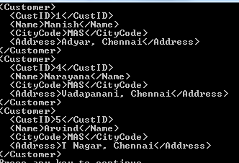
class Program {
static void Main(string[] args) {
string fname=@"E:\cust.xml";
XElement Customers = XElement.Load(fname);
IEnumerable<XElement> custs =
from cust in Customers.Descendants("Customer")
where cust.Element("CityCode").Value == "MAS"
select cust;
foreach (XElement e in custs) {
Console.WriteLine(e);
}
}

Slide 54
LINQ way of building a XML tree
class Program {
static void Main(string[] args) {
XElement Employees =
new XElement("Employees",
new XElement("Employee",
new XElement("Name", "Sahana"),
new XElement("Phone", "9915550144",
new XAttribute("Type", "Home")),
new XElement("phone", "9195550145",
new XAttribute("Type", "Work")) ),
new XElement("Employee",
new XElement("Name", "Anjana"),
new XElement("Phone", "9215550144",
new XAttribute("Type", "Home")),
new XElement("phone", "9134550145",
new XAttribute("Type", "Work")) ));
Employees.Save("E:/Employees.xml");
}

Slide 55
On execution the Employees.xml file that was generated :
<?xml version="1.0" encoding="utf-8"?>
<Employees>
<Employee>
<Name>Sahana</Name>
<Phone Type="Home">9915550144</Phone>
<phone Type="Work">9195550145</phone>
</Employee>
<Employee>
<Name>Anjana</Name>
<Phone Type="Home">9215550144</Phone>
<phone Type="Work">9134550145</phone>
</Employee>
</Employees>

Slide 56
Exercise
Look at the XML given below:
<?xml version="1.0" encoding='UTF-8'?>
<employees>
<person id="1234">
<name>Gayathri Sardar</name>
<office>Arihant Towers, Kandanchavadi</office>
<city>Chennai</city>
</person>
<person id="2345">
<name>Bobby Mahajan</name>
<office>SJR, Electronic City</office>
<city>Bangalore</city>
</person>
</employees>
Write a program to accept input and build the XML like the one.
Write a program to print the names of the person who are from Chennai
(1 hour)

